Slide 1


developer
justin bieshaar
artists
jessie spitteler
iggy finn
lorenzo koning

Slide 2
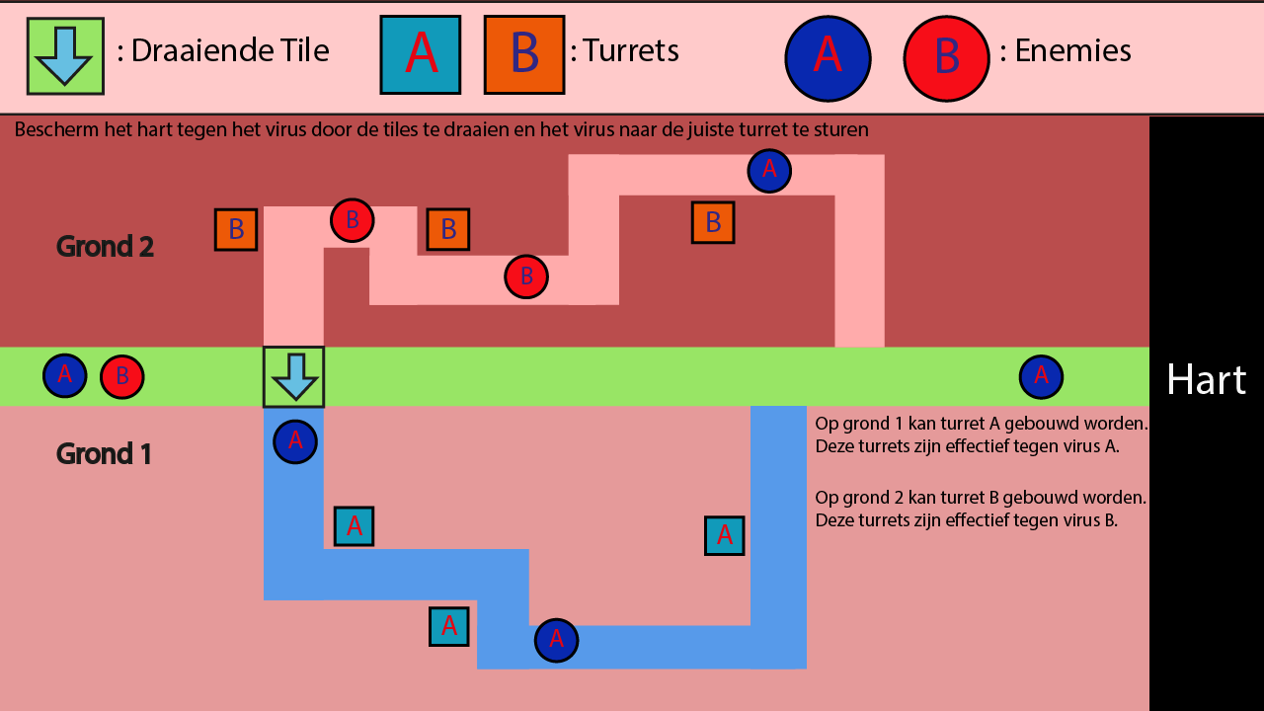

Slide 3
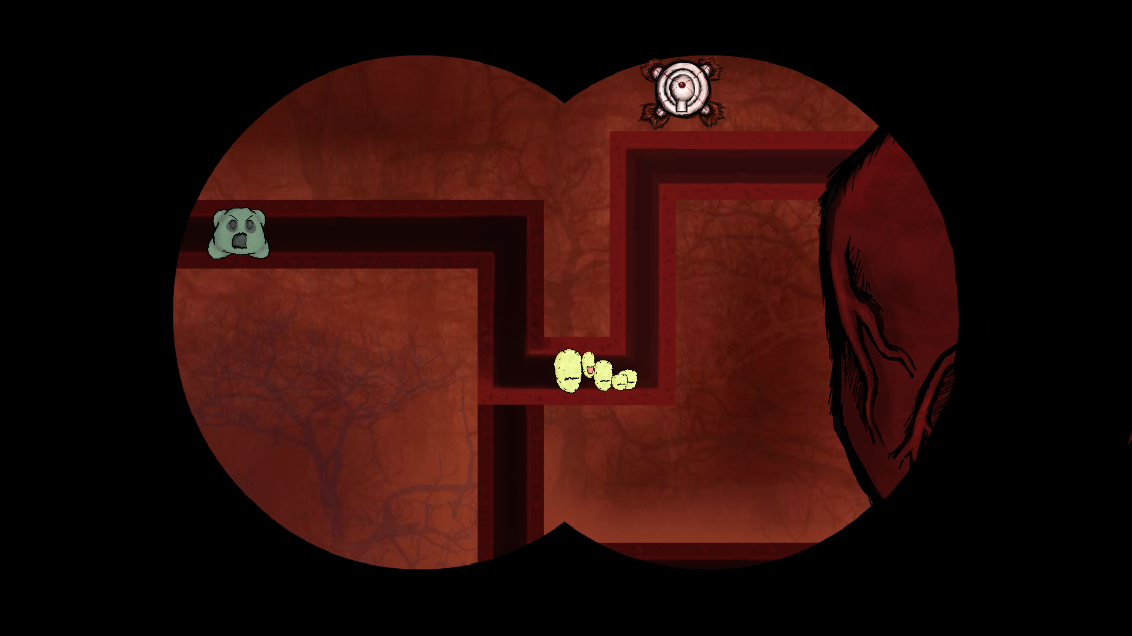
mock-up

Slide 4

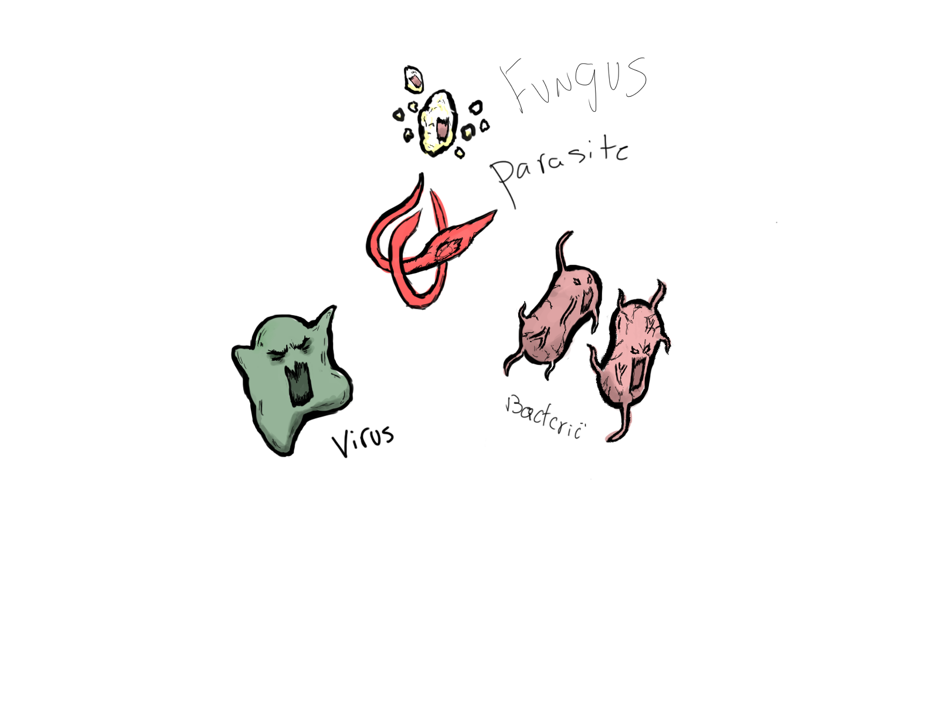












Slide 5


http://tllg.net/towerdefma

